Slide 1


Adverse Incident
Reporting

Slide 2


Providers are required to notify Magellan within 24 hours of the occurrence of a reportable incident involving a HealthChoices member, whether it occurs at the provider’s location or at another location.

Slide 3
If the incident qualifies as a Sentinel Event for a managed level of care, please indicate so on the Incident Report and alert Care Management of the occurrence (for managed levels of care).

Slide 4

Where to access the Incident Reporting Online Portal?

Slide 5
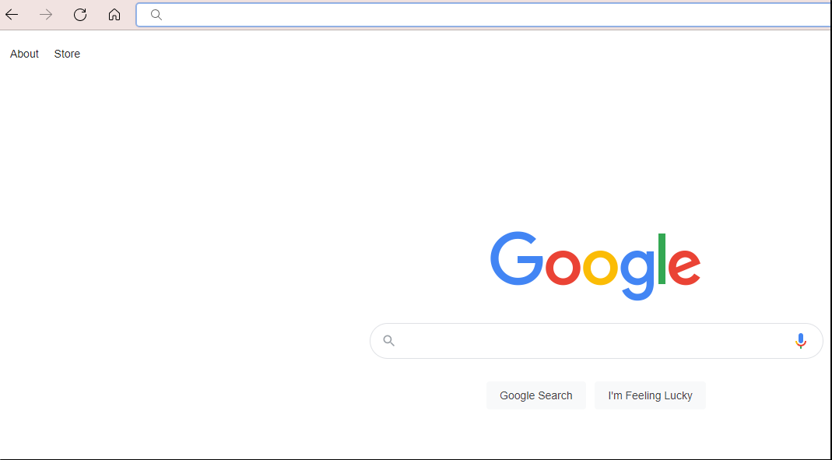
1.
Go to
www.magellanofpa.com

Slide 6
www.magellanofpa.com

Slide 7
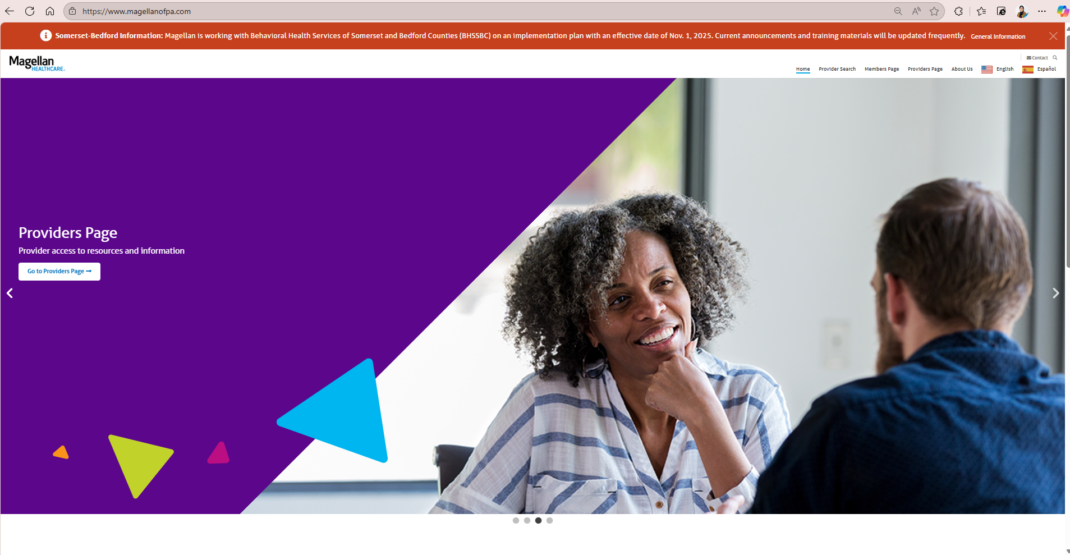
2.
Go to the
“Provider’s Page”

Slide 8
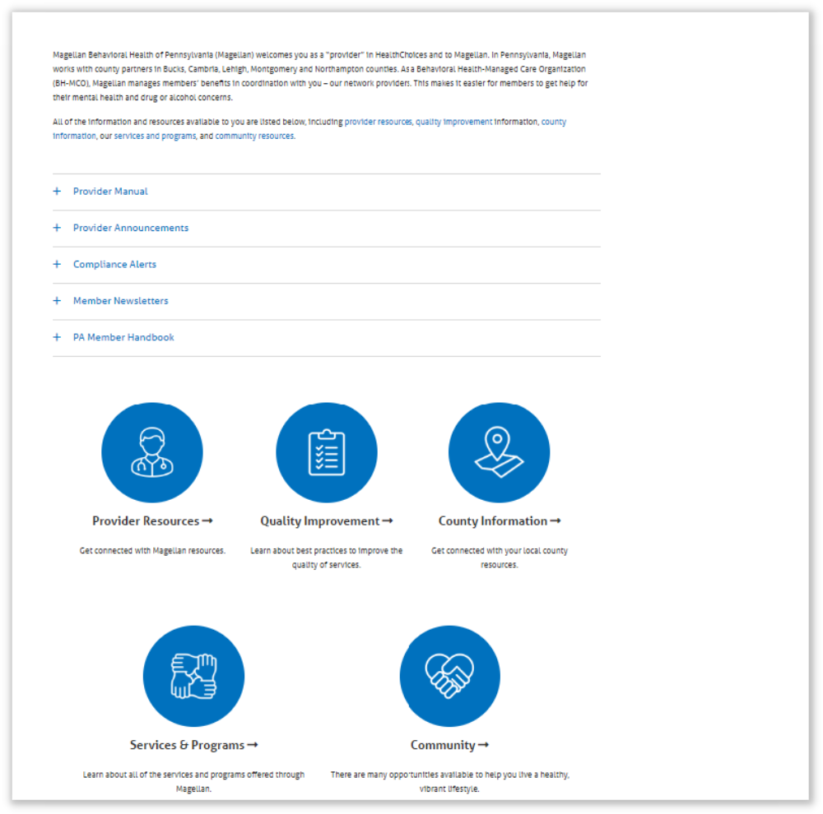
3.
Go to
Quality Improvement

Slide 9

4.
Go to
Patient Safety

Slide 10
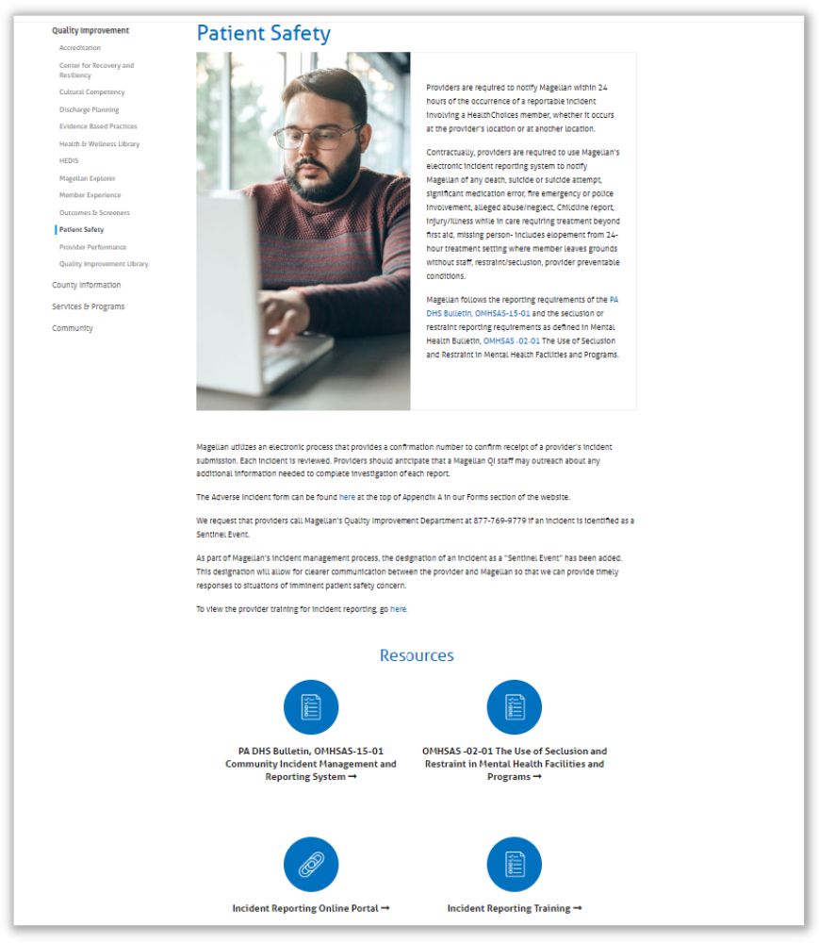
5.
Go to
Incident Reporting Online Portal

Slide 11

Essential Information to Complete Reporting
Program specific MIS number
Member Medical Assistance Recipient Identification Number
The member’s Medical Assistance Recipient ID number is a 10-digit number assigned by the State

Slide 12
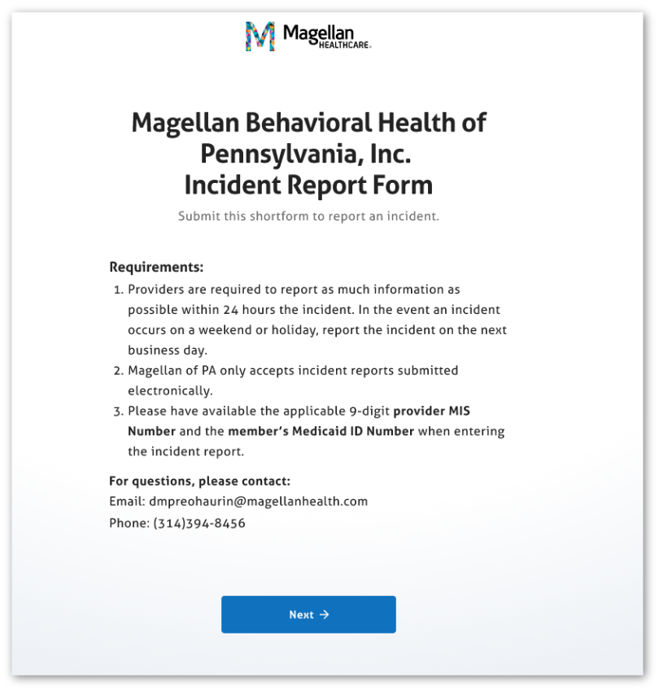
How to complete
a report?

Slide 13
Please attend to the introductory page where “Requirements” are listed. You must have your correct Provider MIS number for your organization, as well as the member’s Medicaid ID number. Your incident report will not be accepted by the system if either of these numbers is missing or invalid.

Slide 14
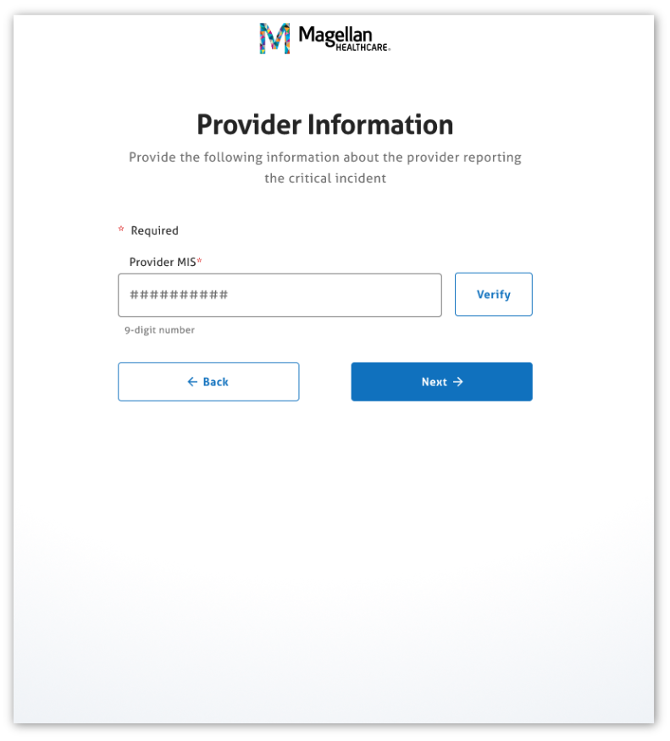
Enter the provider's information.
Please note that fields with asterisk are required fields.
123456789
Enter your organization’s Provider MIS number and click “Verify.”
If your program under that MIS# has one address, this will appear. Click the address. If there are multiple addresses associated with that MIS number, please click the search box to view the drop-down list, and click the correct address. Now you can click “Next.”

Slide 15
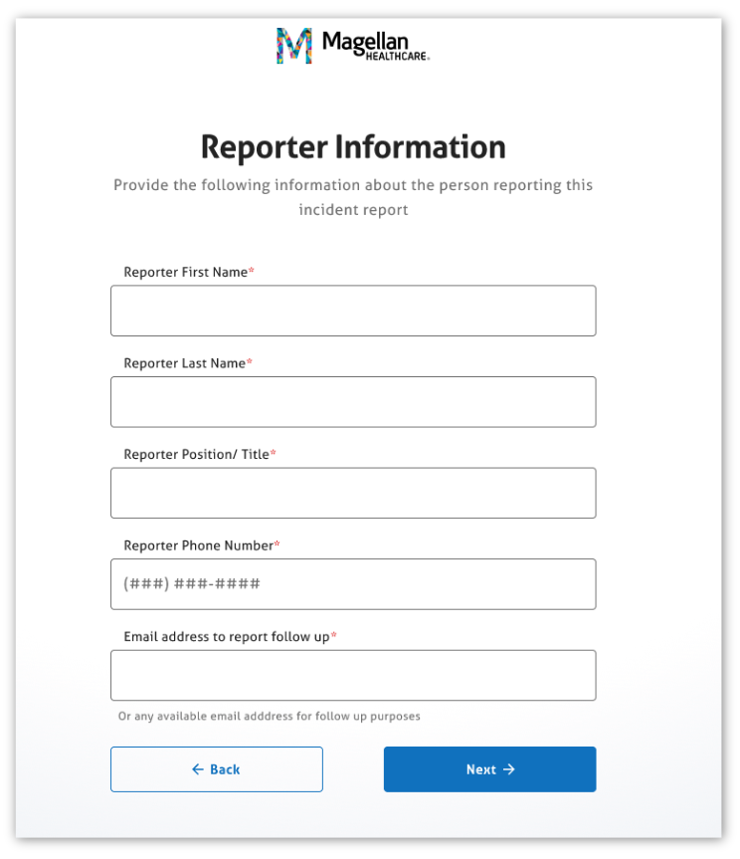
Enter the reporter's information.
Please note that fields with asterisk are required fields.
First Name
Last Name
Title or Position
(123) 456-7890
reporter@mail.com
You are the “reporter.”
Enter your first name, last name, title/position, phone number, and e-mail address. If you are not the person that Magellan should follow up with, please enter the email address of the contact person we should use. Click “Next.”

Slide 16
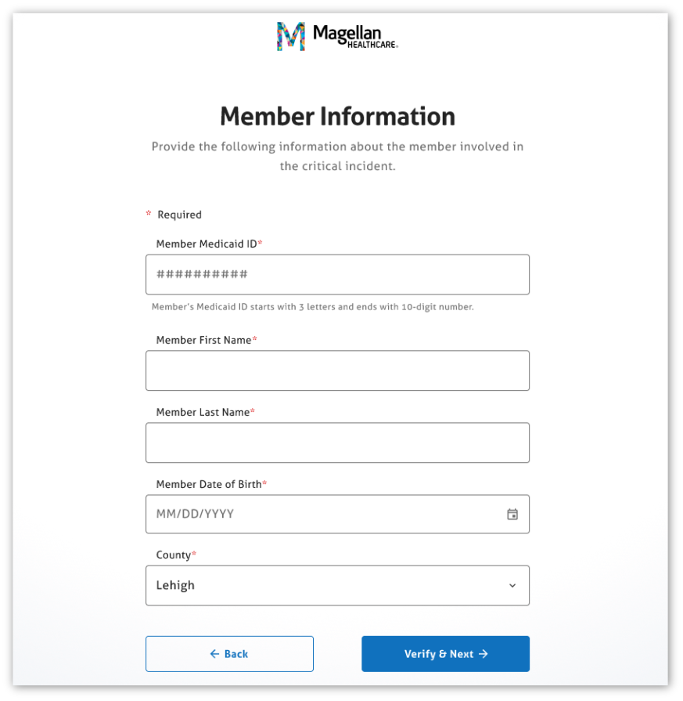

Enter the member's information.
Please note that fields with asterisk are required fields.
ABC1234567890
First Name
Last Name
01-31-2000
Enter the member’s Medicaid ID number. This will be a 3-letter prefix followed by a 10-digit number, with no dashes. Enter the member’s first name, last name, and date of birth.
Also enter the county of the member’s Medicaid eligibility. This should match the prefix of their Medicaid ID number. Click “Verify & Next.” If the system is not accepting the member information, please check your records to verify that the member is a Magellan HealthChoices member, the correct MA ID#, date of birth, and spelling of the member’s name.

Slide 17
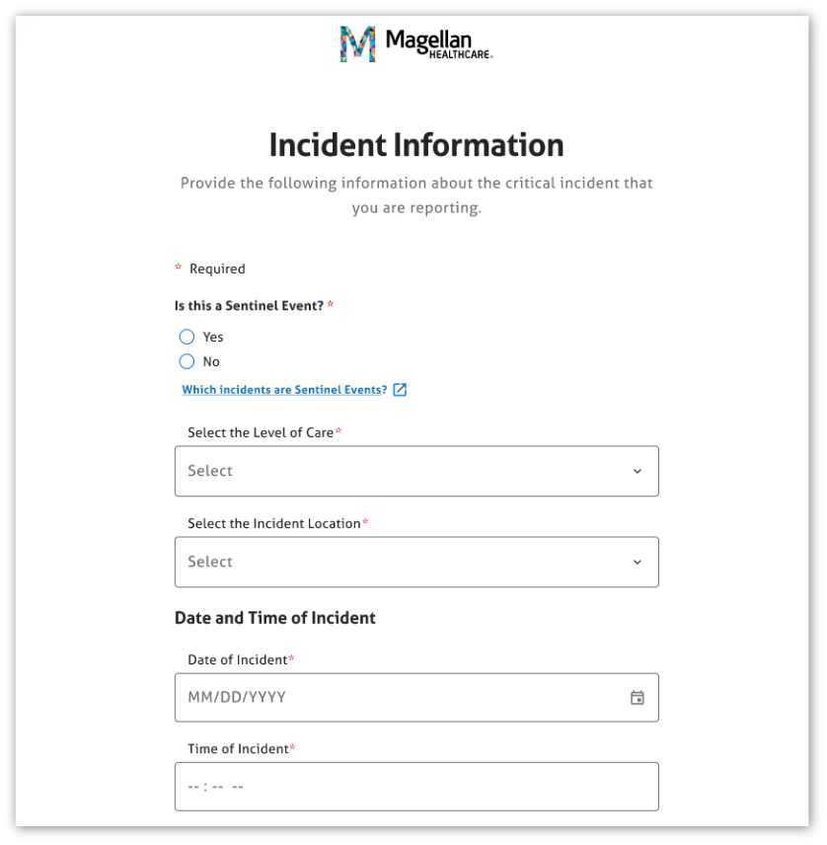
Enter the incident information.
Please note that fields with asterisk are required fields.
Click Yes or No under “Is this a Sentinel Event?” If you need a reminder of which incidents qualify as a Sentinel Event, click the link to view the incident definitions.

Slide 18
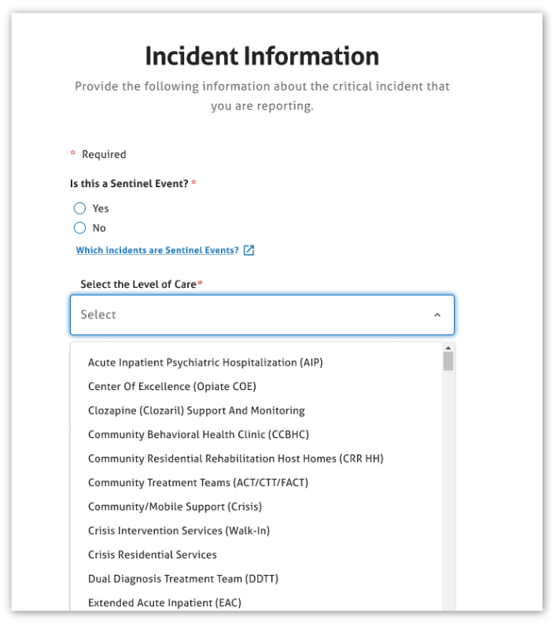
Choose the appropriate Level of Care from the drop down menu.
Please note that fields with asterisk are required fields.
Select the level of care of the program where the member was receiving services when the incident occurred.

Slide 19
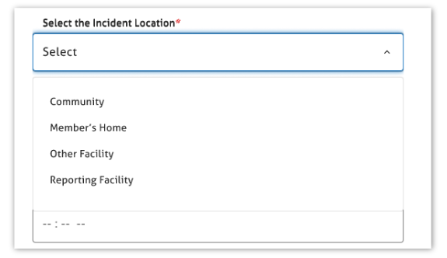
Choose the Incident Location from the drop down menu.
Please note that fields with asterisk are required fields.
Choose “Reporting Facility” if the incident occurred on your program or facility’s premises.
Choose “Other facility” if the incident occurred in a treatment facility other than yours.
Choose Community if the incident occurred in a public place, or a place outside of the program, facility, or home.
Choose “Member’s home” if the incident occurred in the private home of the member. If the member resides in your facility, please choose “Reporting Facility” instead.”

Slide 20
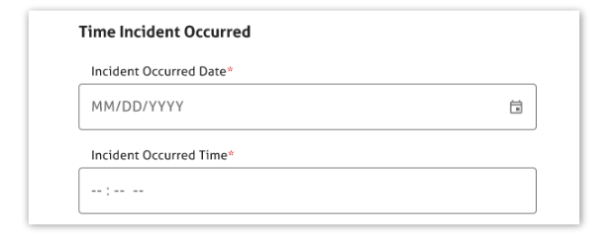
Enter the Incident date and time.
Please note that fields with asterisk are required fields.
Enter the date of the incident. You can type in the date in the format MM/DD/YYYY or by using the calendar function.
Enter the time of the incident (time can be approximate)
Choose the Type of Incident from the drop-down menu. There are brief definitions there to assist you in choosing the correct incident type.

Slide 21
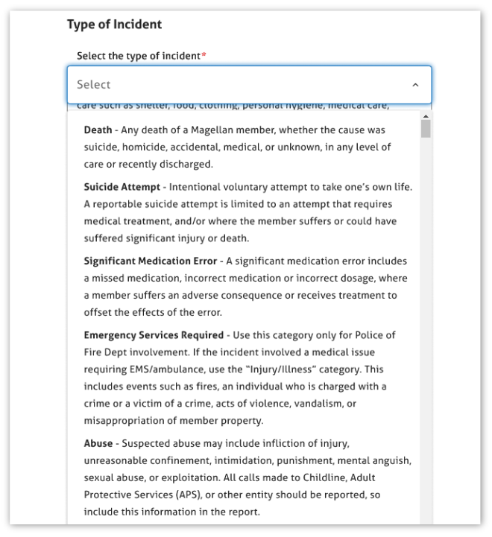
Chose the Incident type from the drop down menu.
Please note that fields with asterisk are required fields.

Slide 22
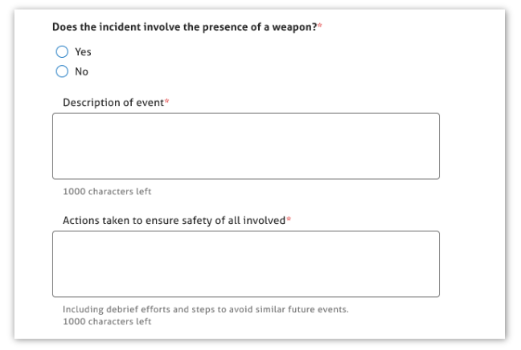
Enter Incident information.
Please note that fields with asterisk are required fields.
Choose Yes or No to indicate if the incident involved the presence of a weapon. If you choose Yes, click the drop-down for “Select type of Weapon.” If you choose “other” you will be required to explain that in the “Please specify the “other” weapon text box.

Slide 23
Enter Incident information.
Please note that fields with asterisk are required fields.
In the text box entitled “Description of Event” please briefly describe the incident. Please be succinct. If Magellan needs additional information or details, we will contact you.
In the text box entitled “Actions taken to ensure safety of all involved” enter the actions that have been taken by staff at your organization to respond to the incident.
Provide a brief but clear description of the incident.
Provide information on the actions taken to ensure safety.

Slide 24
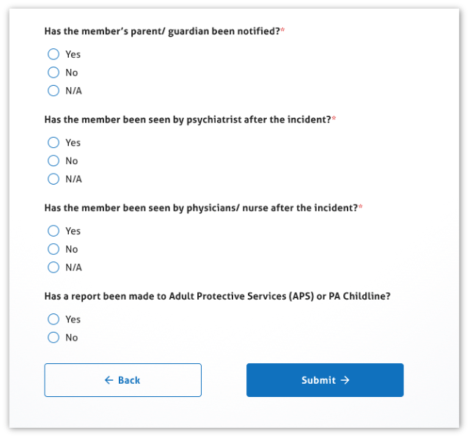
Choose the applicable follow up actions taken.
Please note that fields with asterisk are required fields.
Choose Yes, No, or NA to indicate whether the member’s parent/guardian was notified. If you choose Yes, you will be required to enter the date and time the notification occurred.
Choose Yes, No, or NA to indicate whether the member was seen by a psychiatrist after the incident. If you choose Yes, you will be required to describe what was done or recommended by the psychiatrist.
Choose Yes, No, or NA to indicate whether the member was seen by a physician or nurse after the incident. If you choose Yes, you will be required to describe what was done or recommended by the physician or nurse.
Choose Yes, No, or NA to indicate whether Adult Protective Services (APS) or ChildLine was contacted as a follow-up to the incident. If you choose Yes, enter the report number or name of person you spoke to, and the date the APS or Childline report was made.
Click Submit.

Slide 25
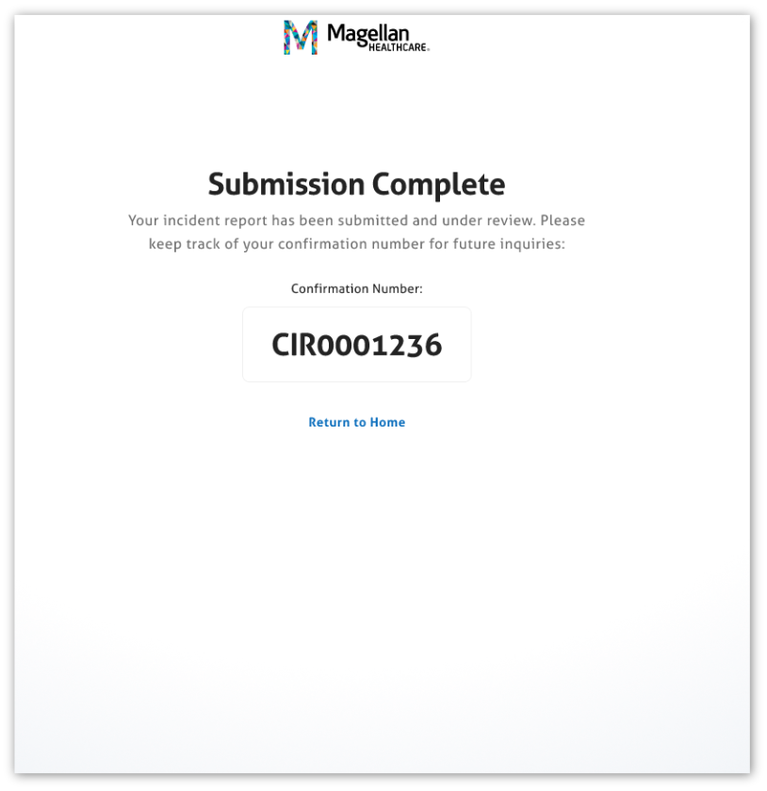
A message will appear to verify that your incident report has been entered. A confirmation number will be provided for the provider record.

Slide 26
If you have questions about the incident reporting process, please call Magellan and request to speak to a Quality Specialist or email Dawn Haurin at DMPrenoHaurin@magellanhealth.com

Slide 28
Confidentiality statement
By receipt of this presentation, each recipient agrees that the information contained herein will be kept confidential and that the information will not be photocopied, reproduced, or distributed to or disclosed to others at any time without the prior written consent of Magellan Health, Inc.
The information contained in this presentation is intended for educational purposes only and is not intended to define a standard of care or exclusive course of treatment, nor be a substitute for treatment.
Notes:
for educational presentations

